Slide 1
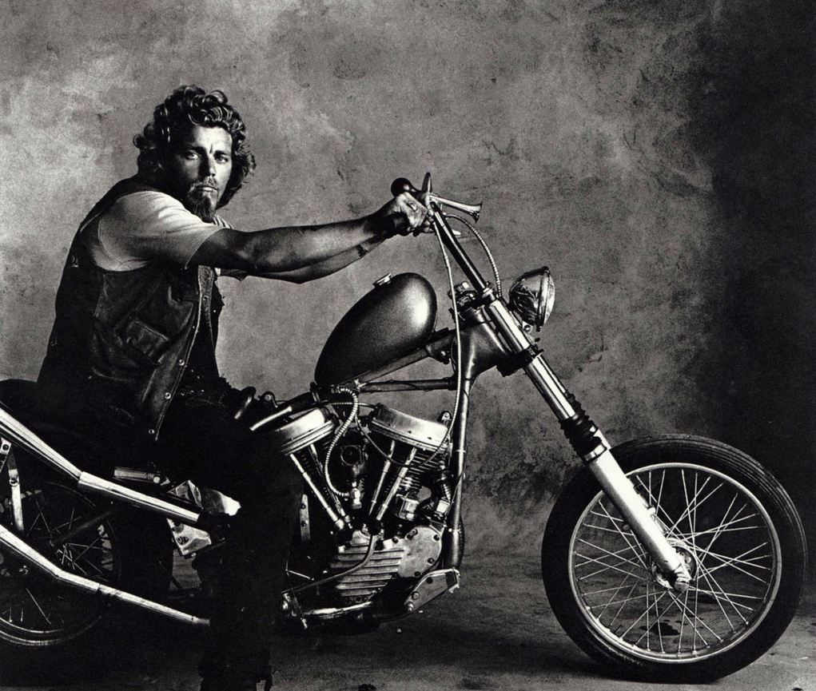
What Hells Angels Taught Us About Website
Usability

Slide 2


Slide 3
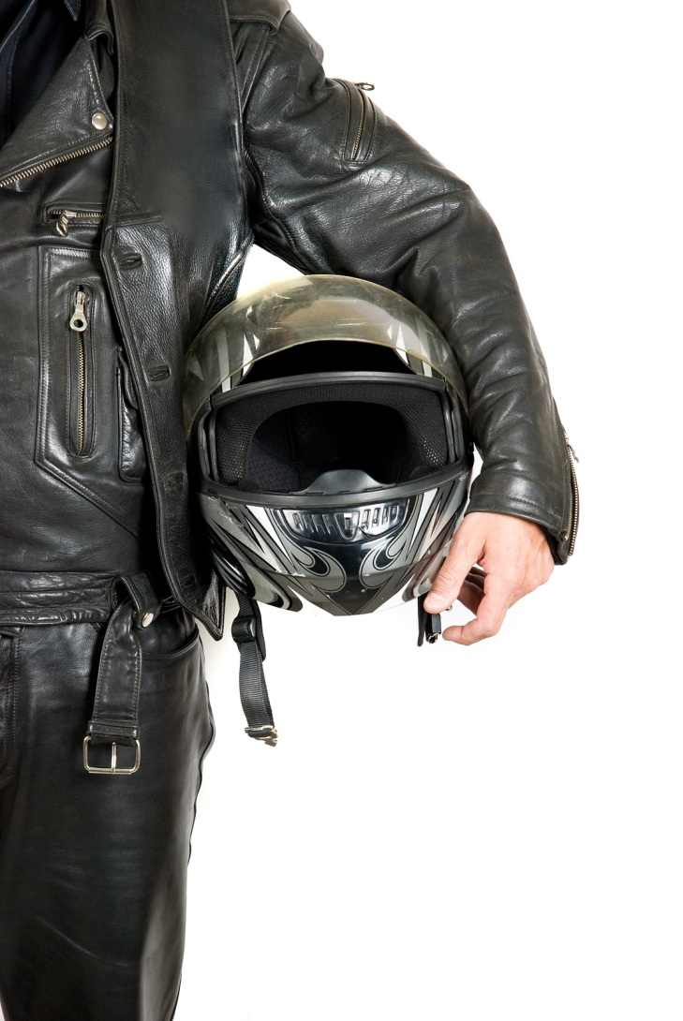

Who Are We?
Keith Dahlby (@dahlbyk)
C# MVP
posh-git
Los Techies
Tim Barcz (@timbarcz)
Former C# MVP
ASPInsider
Devlicious

Slide 4
We’re growing…

Slide 5
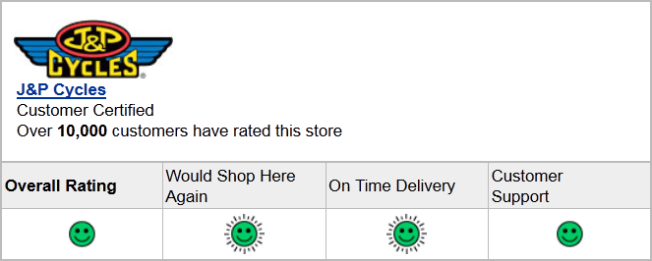
…and growing well…

Slide 6
…but there’s still opportunity.

Slide 7





Slide 8
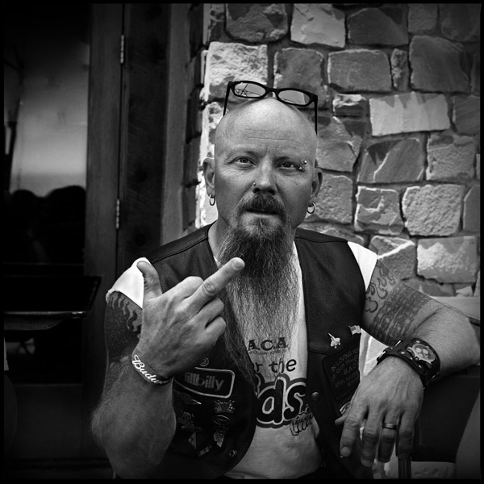
But what if your customers aren’t so friendly…?

Slide 9
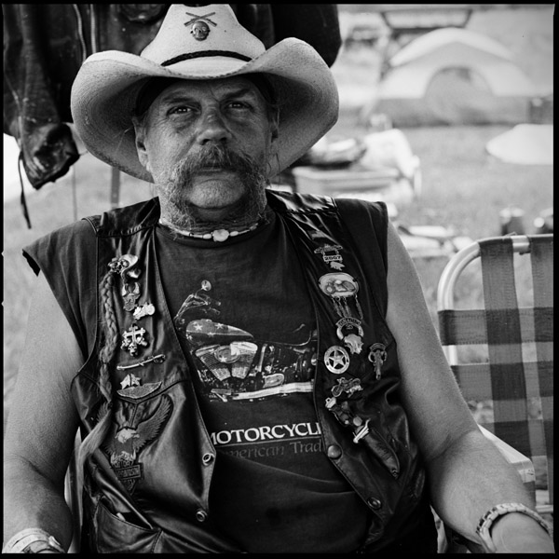
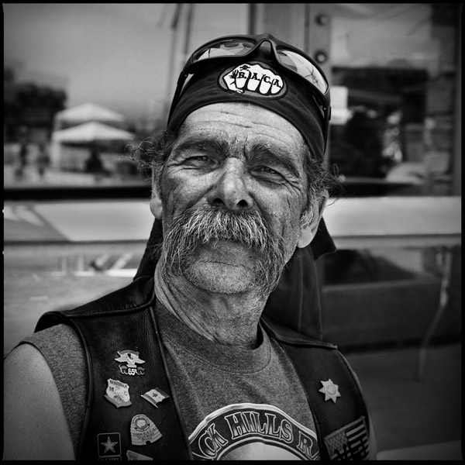
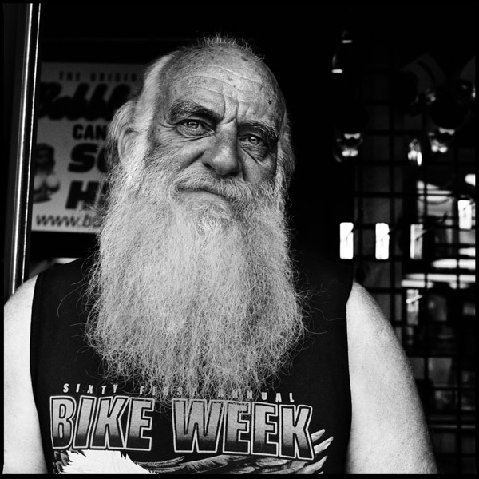
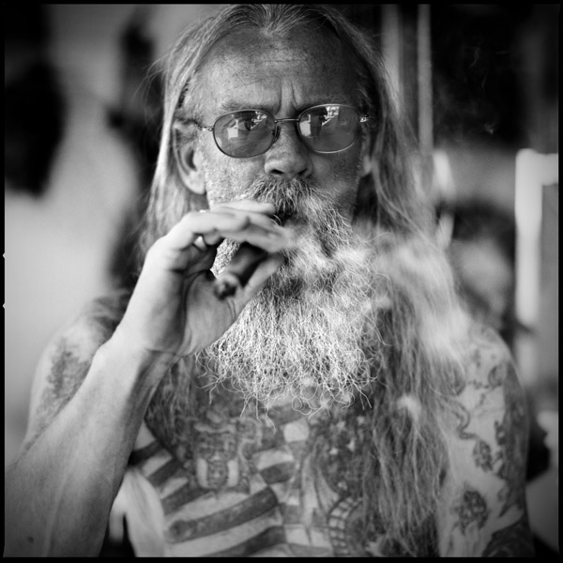
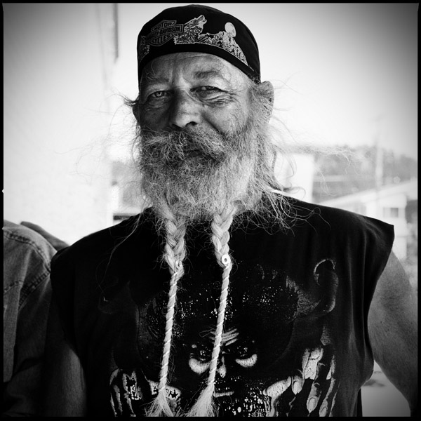
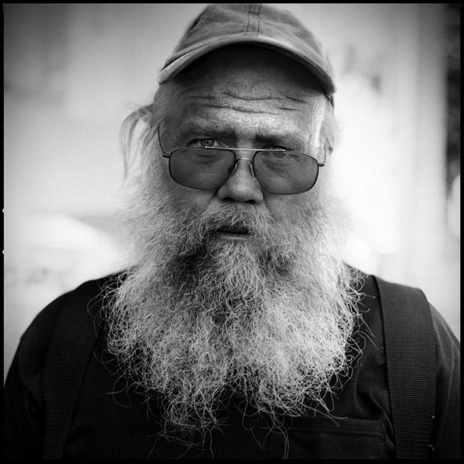
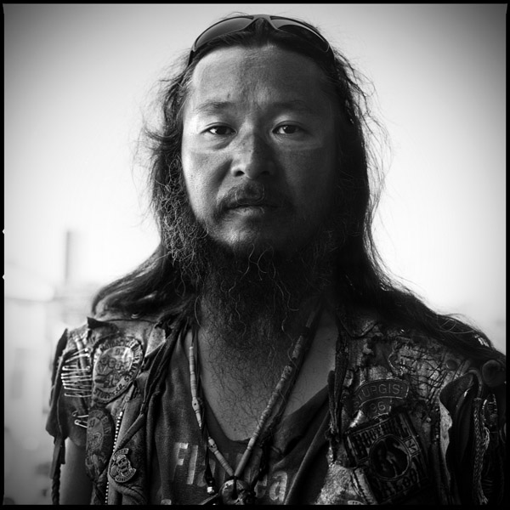
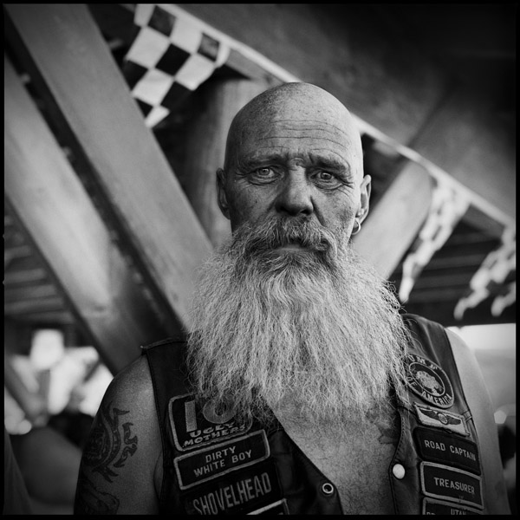
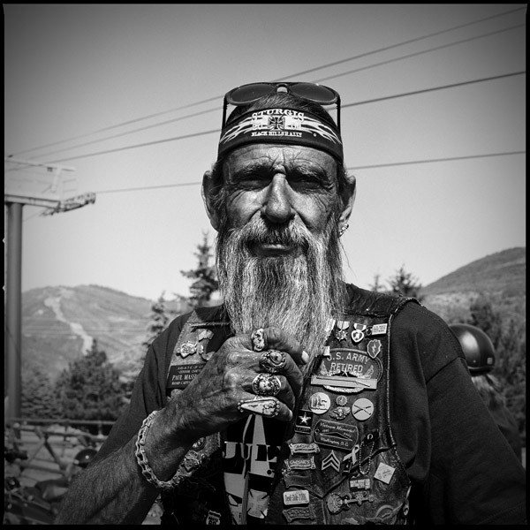
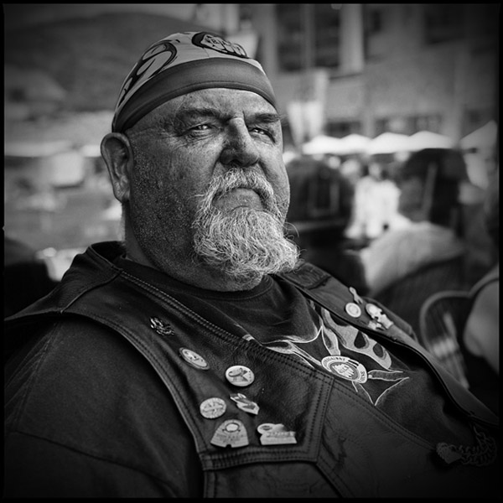
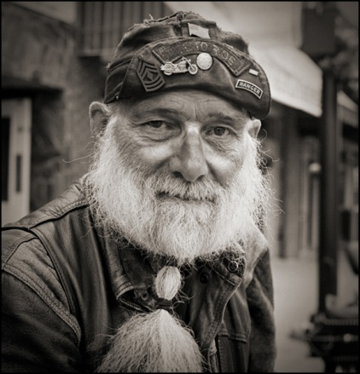
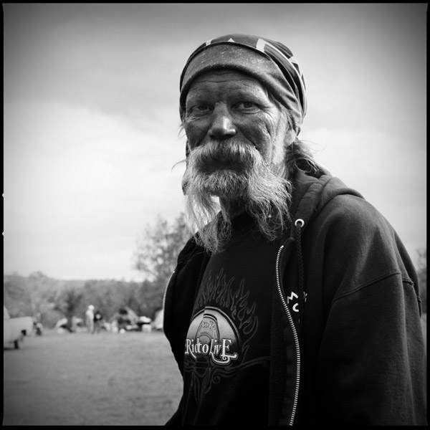

Slide 10
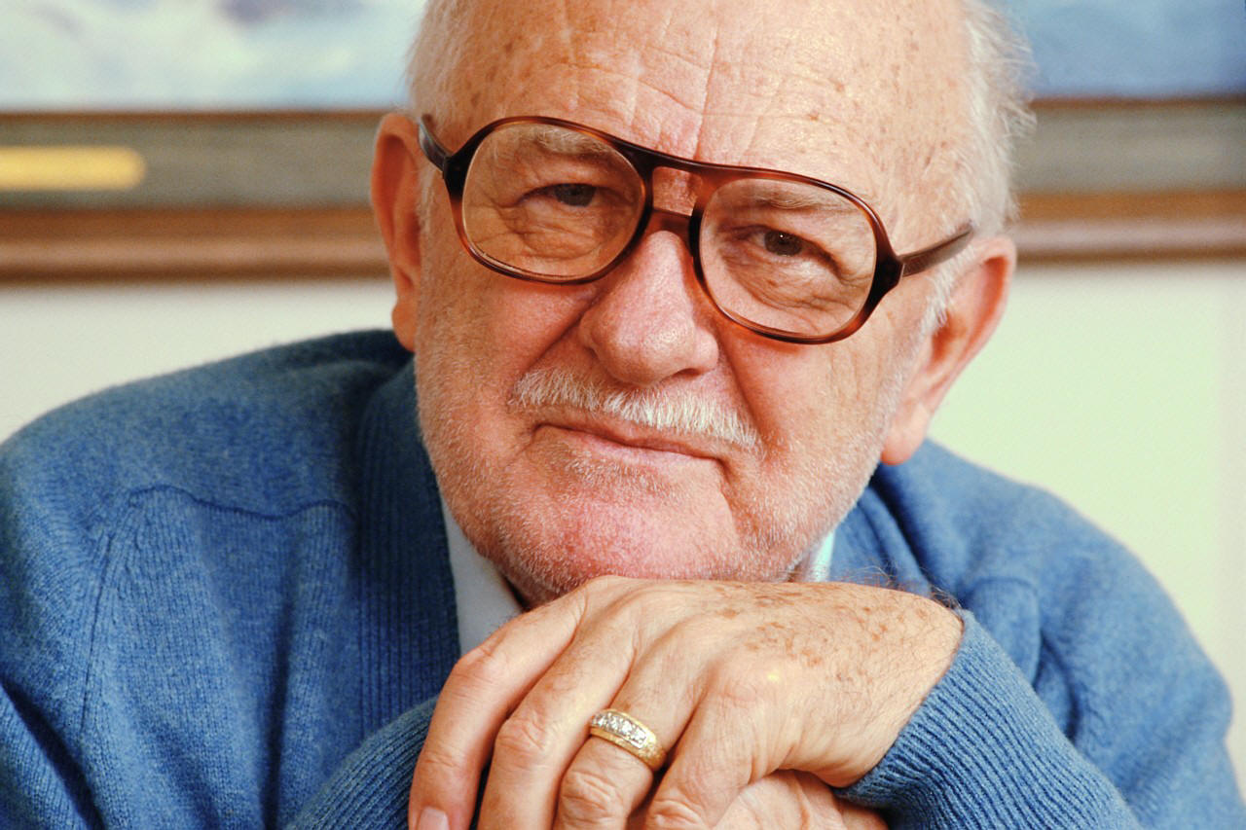

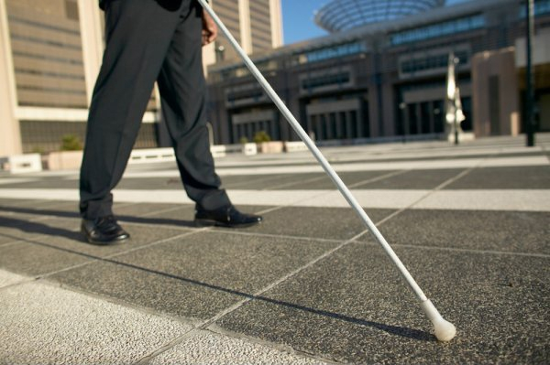
Rule 1: Know Thy Users

Slide 11

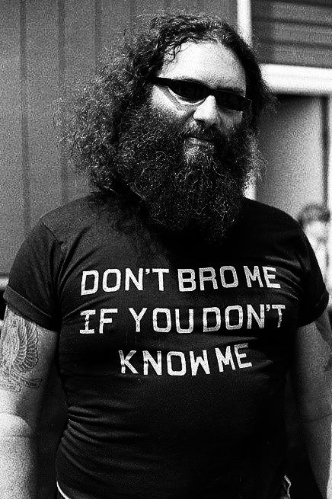
Rule 2: You Are Not Your user*

Slide 12
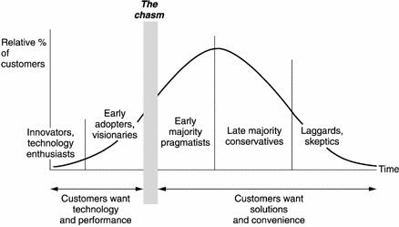
* But…What about technology adoption lifecycle?

Slide 13
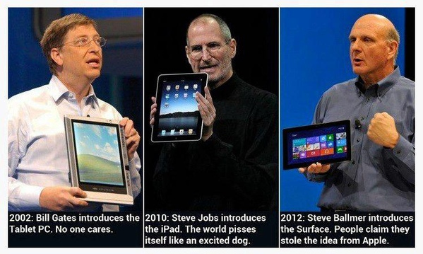

Slide 14
"I've been doing some more online shopping and if I get frustrated a couple of times I just click out. It's like dealing with a rude clerk."
- Uncle Bill

Slide 15
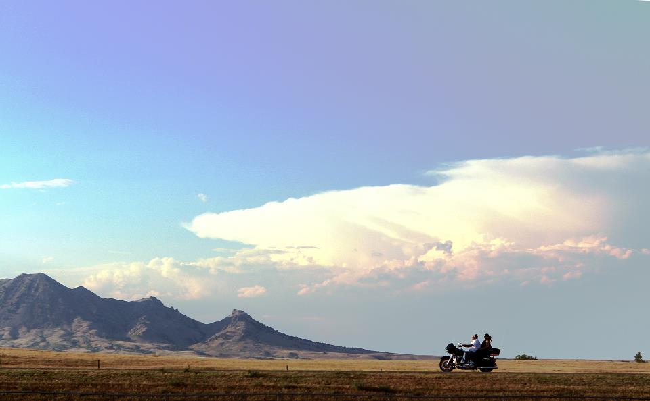
Usability Defined
Learnability
Efficiency
Memorability
Error frequency
Satisfaction

Slide 16
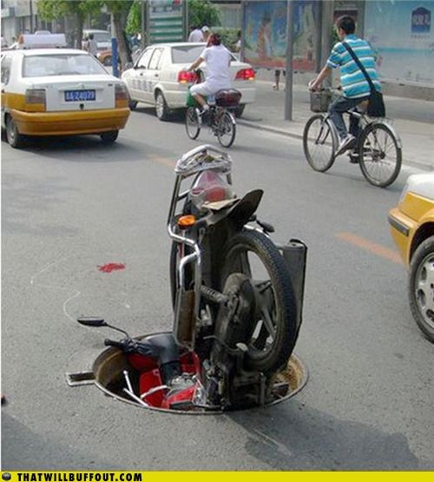

Slide 17
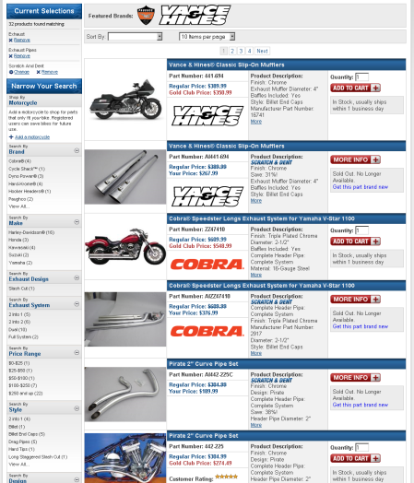

Slide 18
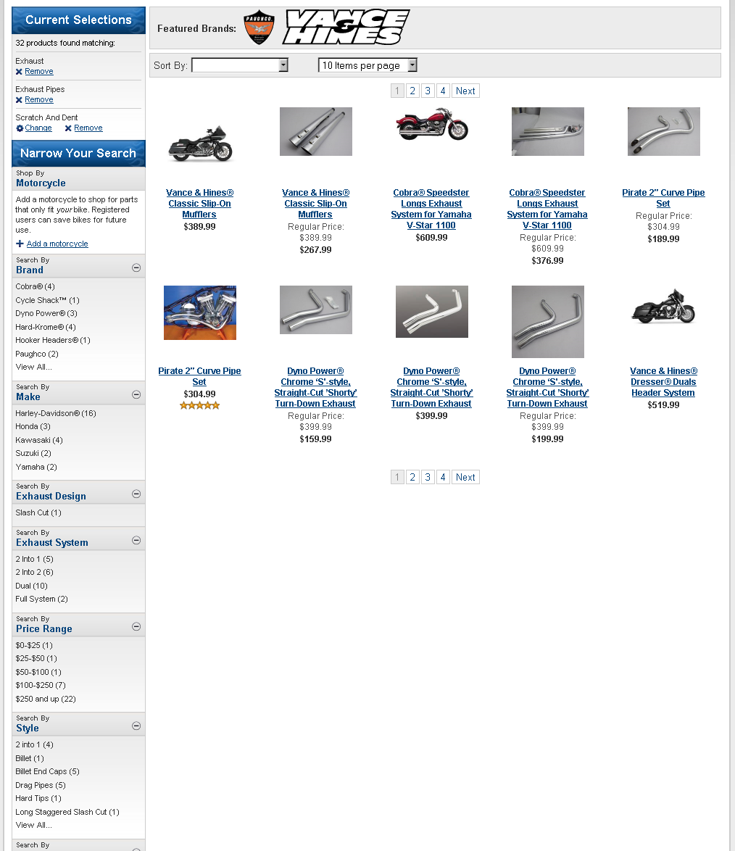

Slide 19
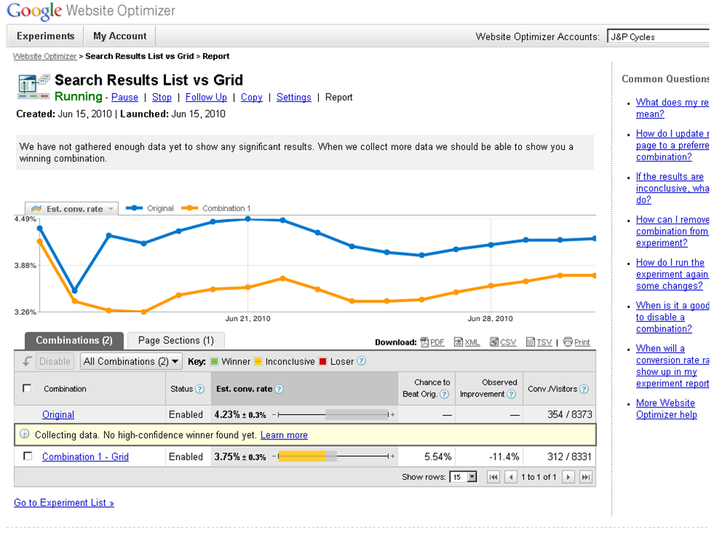
…

Slide 20
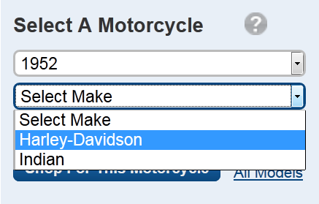

Slide 21
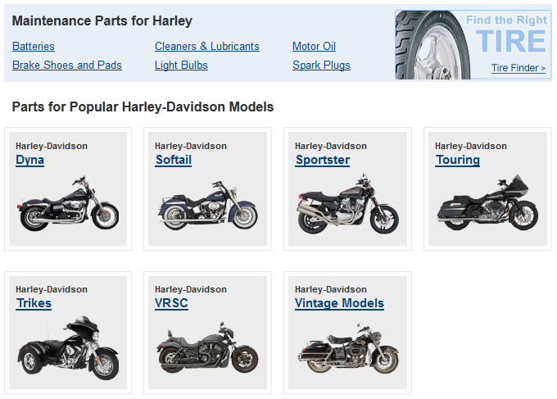

Slide 22
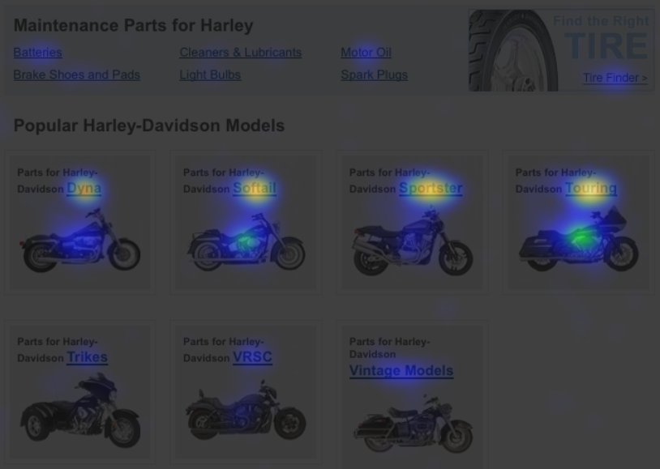

Slide 23
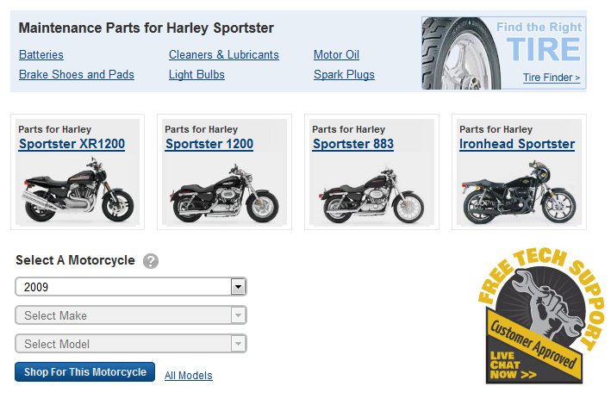

Slide 24
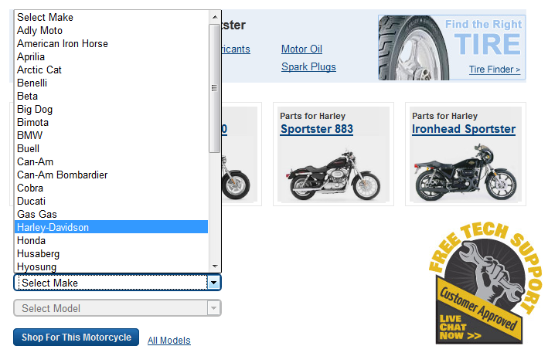

Slide 25
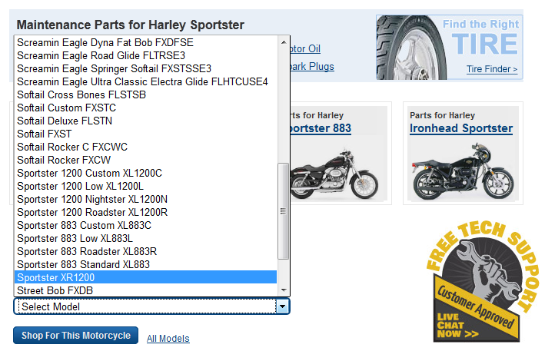

Slide 26
usable all the things
Personas
Data
Behavior
Feedback

Slide 27
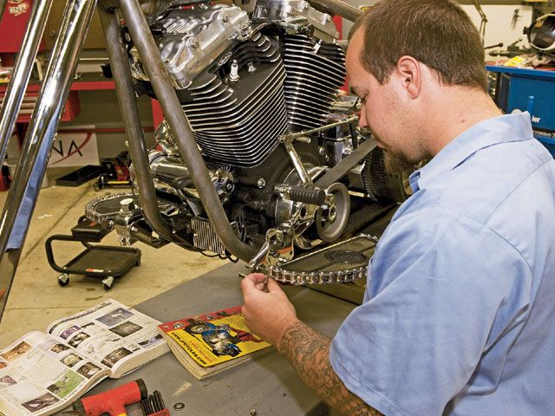
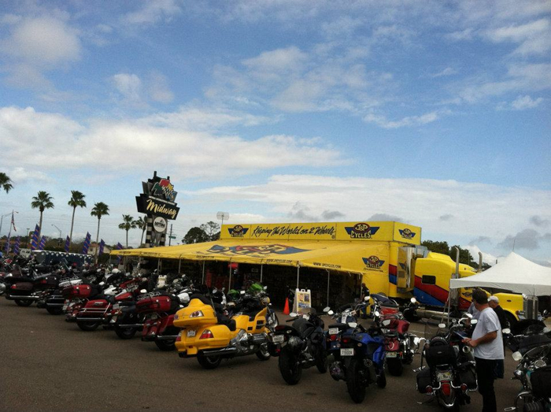
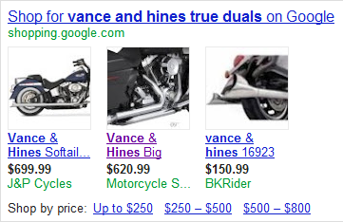
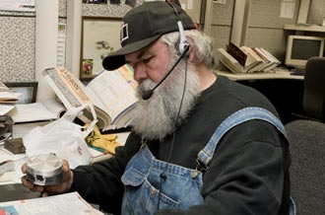

Slide 28
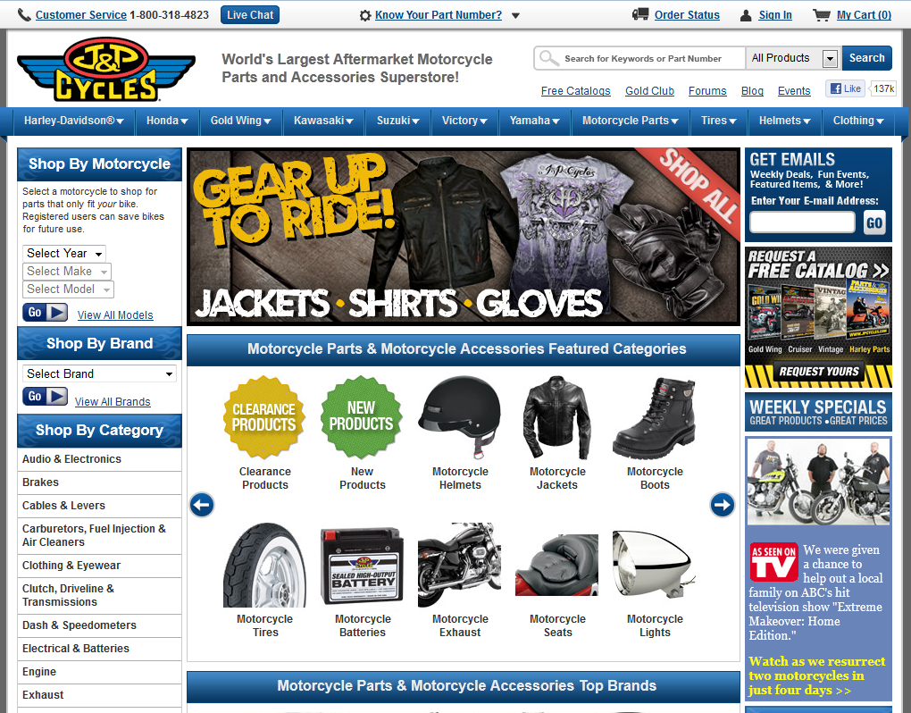

Slide 29
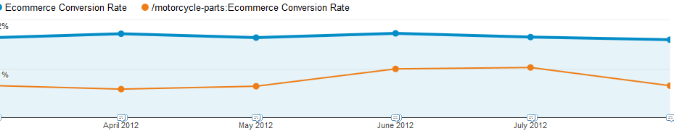
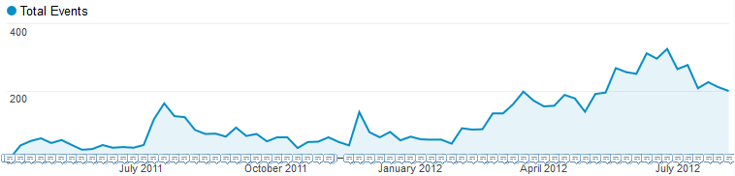

Slide 32
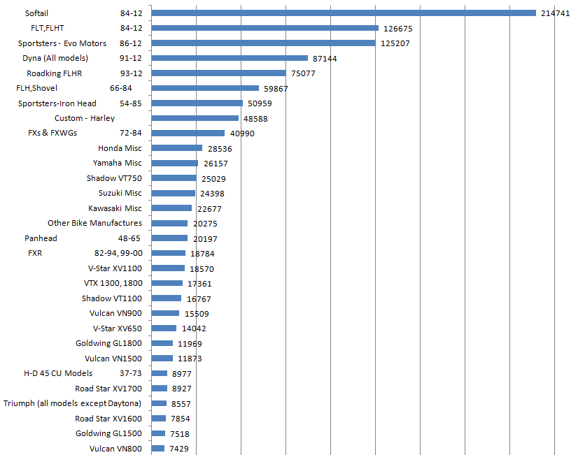

Slide 33
jpcycles.com/catalogrequest

Slide 34
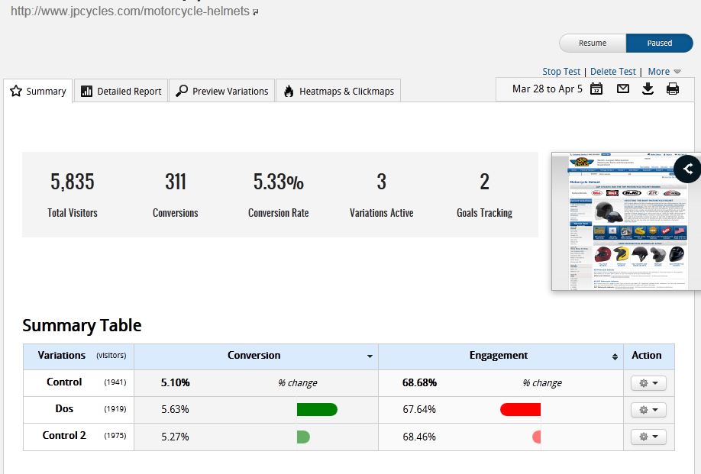

Slide 35
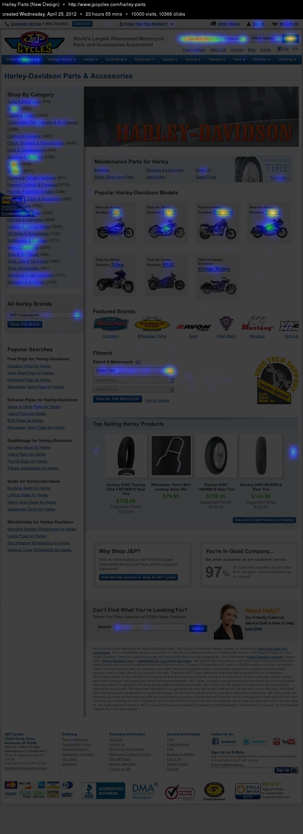
Behavior
Heatmaps
<Crazy

Slide 36
http://websort.net/s/885E35/

Slide 37
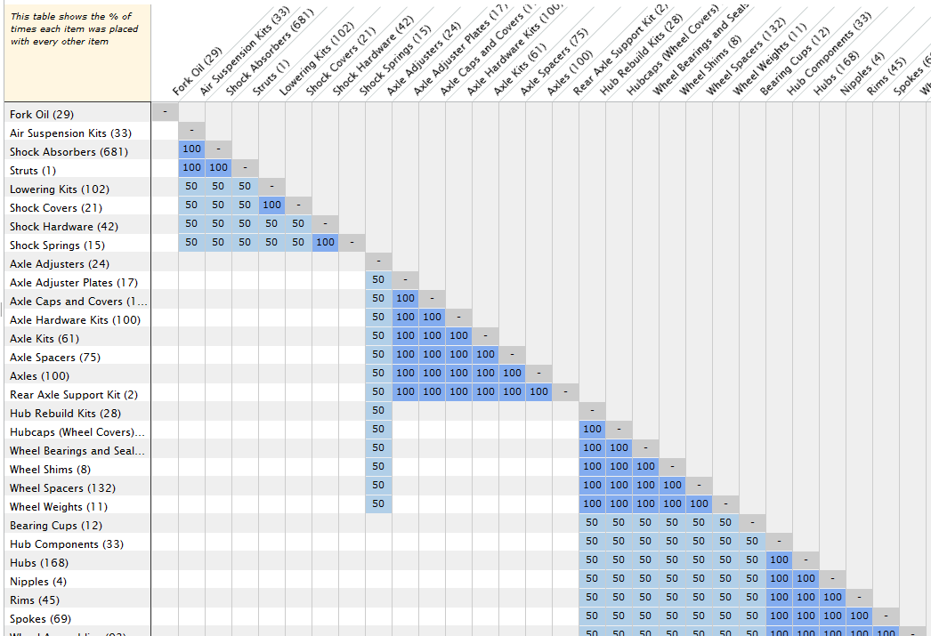

Slide 38
“Across all three studies, seven out of nine users preferred the current homepage over the redesign that they personally viewed.”

Slide 39
Rule 1: Know Thy Users
Personas
Data
Behavior
Feedback
Rule 2: You Are Not Your user

Slide 40
Questions?
http://spkr8.com/t/16891

